Slide 1



Employee Retention Prediction
CONFIDENTIAL: The information in this document belongs to Boston Institute of Analytics LLC. Any unauthorized sharing of this material is prohibited and subject to legal action under breach of IP and confidentiality clauses.

Slide 2



EMPLOYEE
RETENTION
PREDICTION
This project aims to develop a machine learning model to predict whether data scientists are likely to seek job changes, aiding in talent retention and recruitment planning.
Presentated by Rupal Sirohi

Slide 3
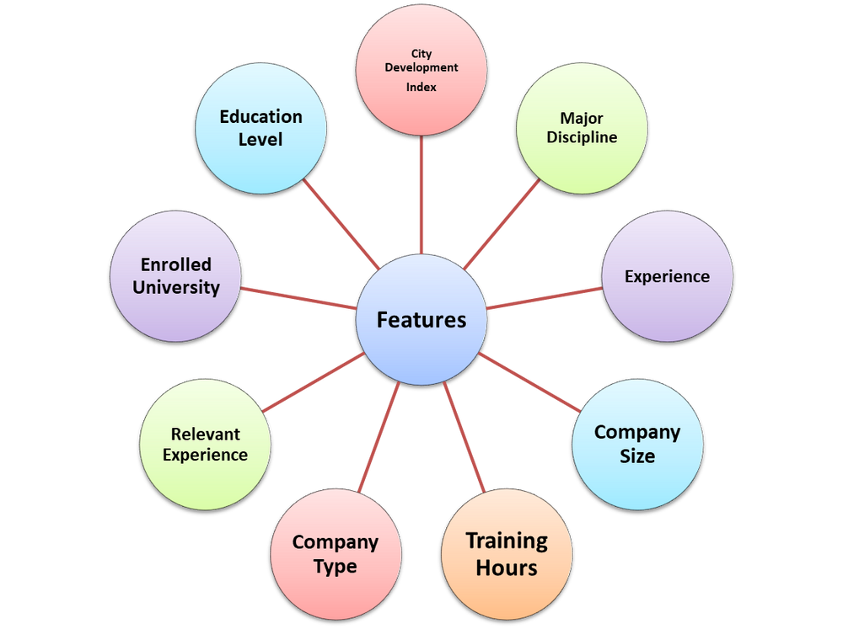
INTRODUCTION
•Employee retention prediction means using data and predictive analytics to forecast which employees are likely to leave their current positions and to identify factors that might be contributing to their potential departure.
•Two main datasets used: aug_train.csv and aug_test.csv
•Each record represents an employee with 14 attributes.

Slide 4


Business Context
High attrition disrupts workflows and team stability.
Recruiting replacements is costly and time- consuming.
Retaining talent boosts productivity and morale.
Why this
matters
Predict employees likely to leave using machine learning
Enable HR teams to optimize resource allocation.
Provides actionable insights for retention strategies
Objective

Slide 5




Data Collection
Step
01
Gathering and Organizing Data to train machine learning model
Exploratory Data Analysis
Step
02
Analyzing and Visualizing data patterns to understand its characteristics
Preprocessing
Step
03
Preparing and Cleaning data to enhance its quality and suitability
Step
04
Split Train and Test Data
Dividing the Dataset into training and testing sets to evaluate
Step
05
Model Selection and Model Training
Choosing a suitable Machine Learning algorithm and optimizing its parameters
Model Evaluation
Step
06
Assessing the performance of a Machine Learning models using metrics

Slide 6

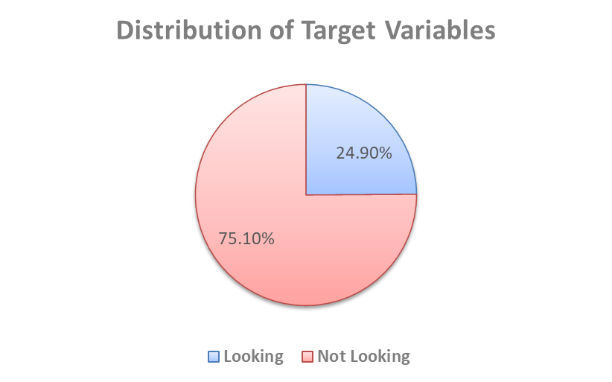
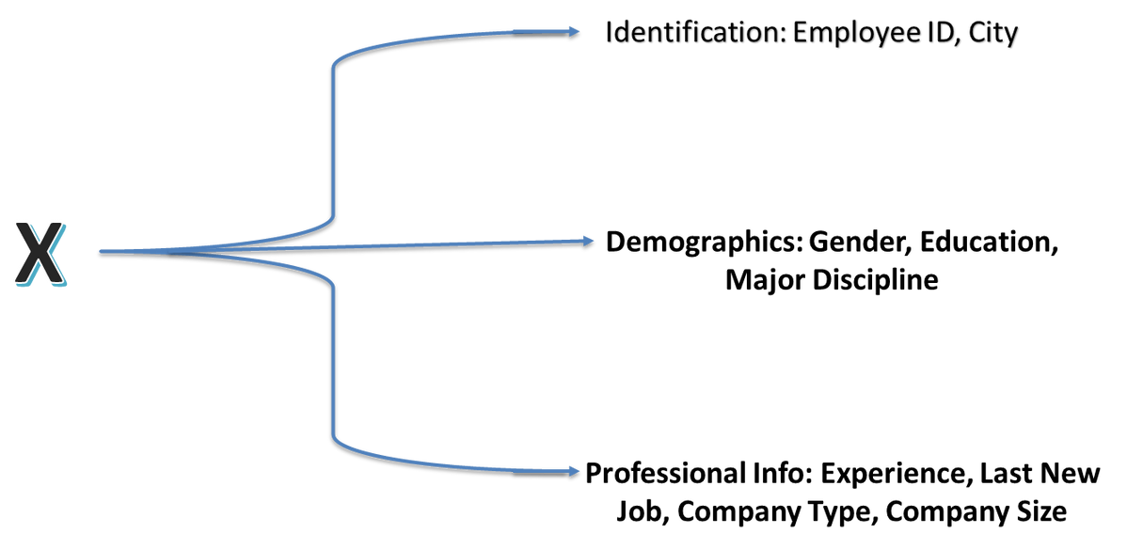
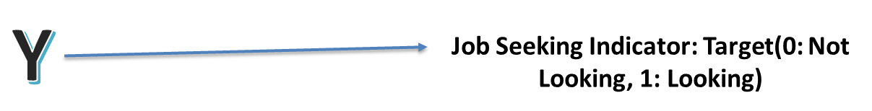
Datasets | Rows | Columns | Purpose
Train | 19158 | 14 | Model Training
Test | 2129 | 13 | Model Evaluation
Data Collection

Slide 7


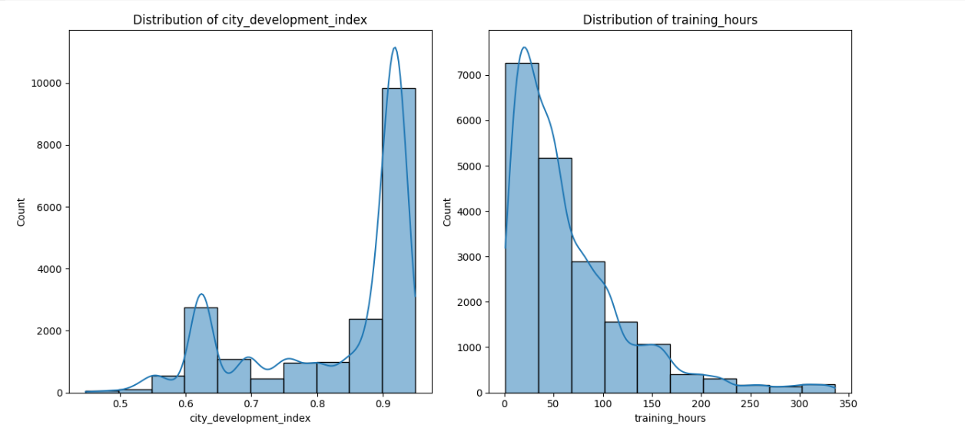
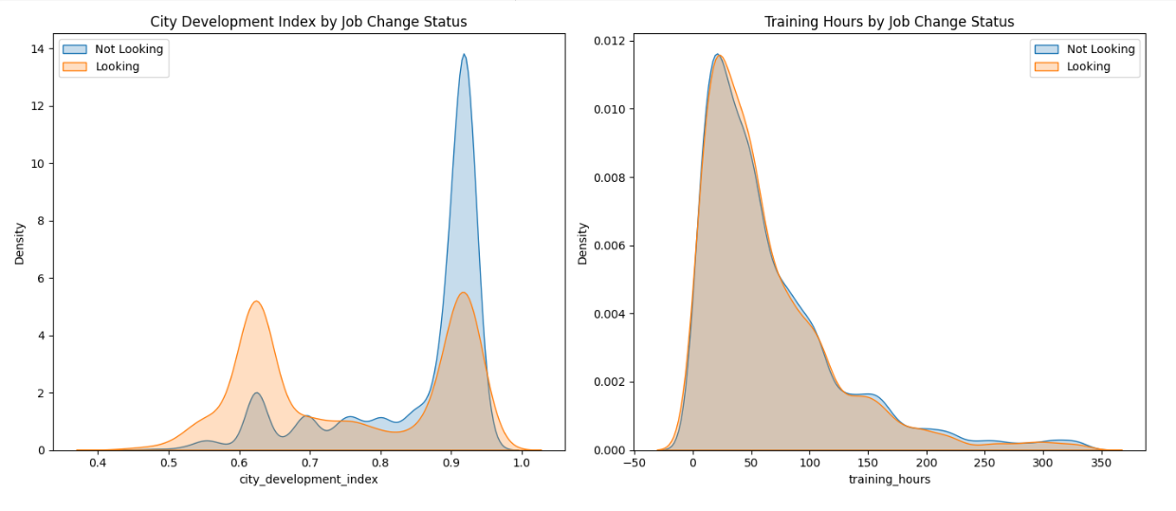
EXPLORATORY DATA ANALYSIS (EDA)
DISTRIBUTION OF CONTINUES VARIABLE
Large number of entries are from highly developed cities
Majority of individuals have training hours between 0–50
CONTINUES VARIABLE VS. TARGET VARIABLES
Those from less developed cities are more likely to be seeking a job change. Those from highly developed cities are more stable
Training hours have little influence on job change status, but slight variations suggest that some job seekers may be investing in additional training

Slide 8
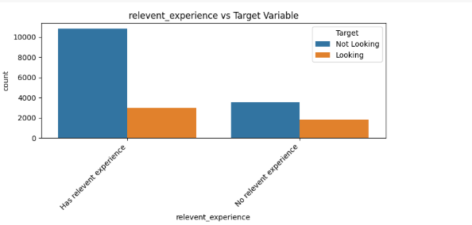
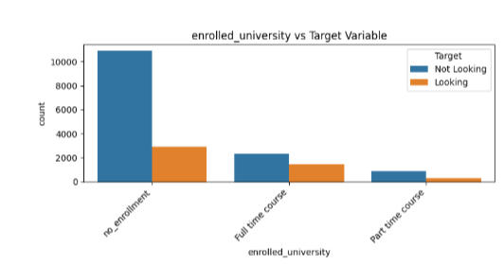
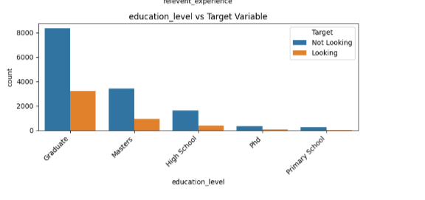
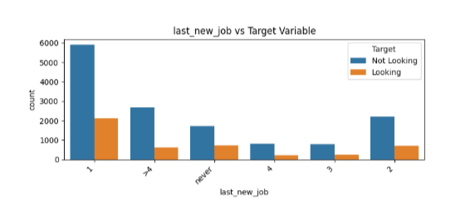
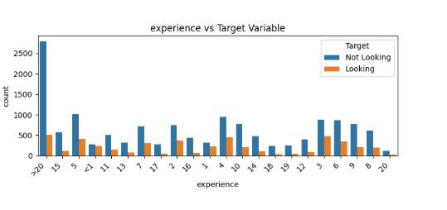
CATEGORICAL VARIABLES VS. TARGET VARIABLE
Lack of relevant experience and ongoing education (enrolled students) are associated with higher job change interest.
Job change interest tapers off as experience increases
STEM graduates, early-career professionals, and those in mid-sized Pvt Ltd companies are most prone to job changes.
Employees who switched jobs 1 year ago are more likely to look for new opportunities again, possibly indicating dissatisfaction or short-term tenures.
Long-term employees (>4 years or never switched) show a decent level of interest in exploring new roles.
Mid-tenure employees (2–4 years) seem relatively more stable.

Slide 9


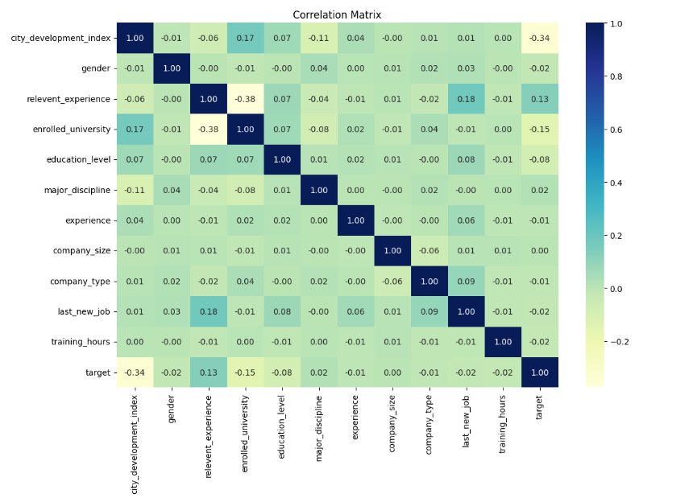
Correlation Matrix
City Index: Lower city development index links to higher attrition.
Training Hours: Fewer training hours increase attrition risk.
Demographics: Younger employees show higher attrition rates.
Variables somewhat correlated with target:
city_development_index: -0.34
Negative correlation – people from more developed cities are less likely to change jobs.
relevent_experience: +0.13
Having relevant experience slightly increases the likelihood of job change.
enrolled_university: -0.15
Those enrolled in university are slightly less likely to switch jobs.

Slide 10



Data Preprocessing and Feature Engineering
Irrelevant Feature Removal: All features in the dataset appears to be relevant except Employee ID and City. So these two columns have been removed using Drop Function.
Missing Values Treatment: Missing values were there only in categorical columns so these values were removed using Ffill and Bfill method.
Categorical Feature Encoding: Applied Label Encoding
Feature Scaling: Important for sensitive algorithms. In this StandardScalar has been used

Slide 11

Smote
Training data becomes balanced, helping the model learn both classes effectively.
Splitting the Data into X and Y
Dataset is divided into two parts X and Y.
“X”: Independent Variables
“Y”: Dependent Variables
Train Test Split
Data is divided into Training (80%) and Testing (20%) sets.
Setting a random state at 42 ensures consistent results.

Slide 12

Logistic Regression
Commonly used for binary classification problems. It is preferred because it provides a simple and efficient way to model the relationship between the independent variables and the probability of a certain outcome.
Model Selection
Decision Tree
Commonly used for classification because they are simple, computationally efficient, efficient, and effective in handling high- dimensional data. Works best for categorical independent columns.
Random Forest
Its is a robust supervised algorithm suitable for both regression and classification tasks.
XGBoost
XGBoost (short for Extreme Gradient Boosting) is a powerful machine learning algorithm based on gradient boosting. It is widely used for structured (tabular) data in classification, regression, and ranking tasks.

Slide 13
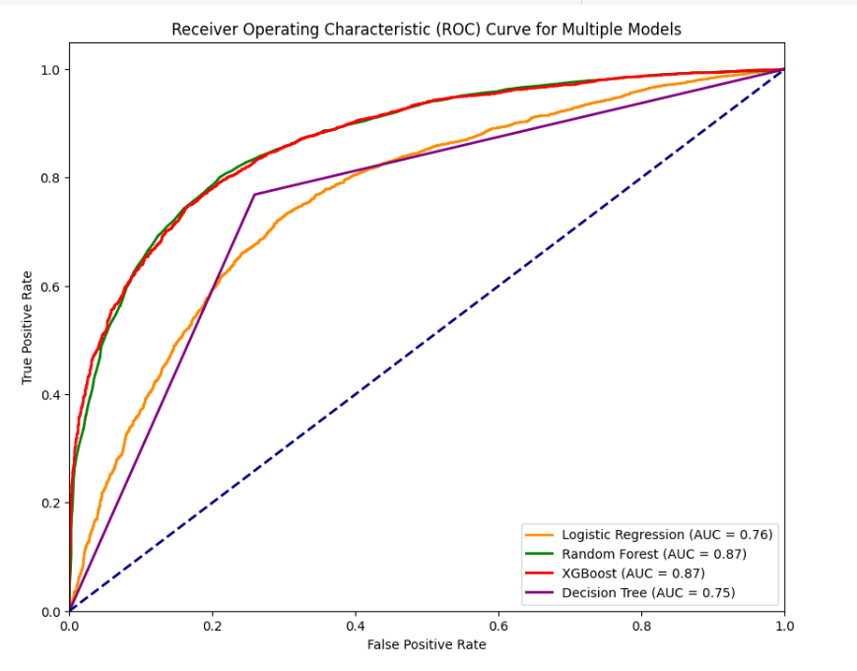

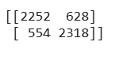
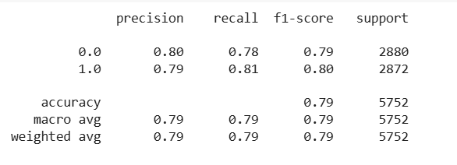
 | Accuracy | Precision | Recall | F1-score
Logistic Regression | 0.71 | 0.70 | 0.73 | 0.71
Random Forest | 0.79 | 0.79 | 0.81 | 0.79
XGBoost | 0.78 | 0.79 | 0.78 | 0.79
Decision Tree | 0.75 | 0.76 | 0.74 | 0.75
Why Random Forest?
Accuracy is 0.79 (Highest among all)
Precision (0.79):
Of predicted “job‑seeking” candidates, 79% are correctly identified.
Recall (0.81):
Of all actual job‑seekers, the model identifies 81%.
Which to Prioritize?
Recall
Context: High‑stakes hiring → missing good candidates is costlier than some irrelevant outreach

Slide 14

Conclusion...
Limitations:
⚠️ Significant missing values in key features like gender and company type.
📉 Imbalanced target variable may affect prediction accuracy.
🌍 Lack of contextual factors like salary, role, and job satisfaction.
Future Research:
🔍 Collect additional features like salary, job role, and job satisfaction for deeper insights.
⚖️ Conduct fairness audits to ensure the model performs equally across demographics.
📊 Use time-series or longitudinal data to track employee behavior over time.
🔁 Build a real-world feedback loop to continuously retrain and improve the model.
Key Findings
Accuracy of all the models are almost same but Random Forest is a good choice due to non linearity in data, Ability to handle missing and categorical variables (after preprocessing)
✅ Dataset is imbalanced, with only 25% likely to change jobs.
👨‍💼 Majority of candidates are male, graduates, and from STEM fields.
🧠 Candidates with relevant experience are more likely to switch jobs.
🎓 Education level and university enrollment show predictive significance.
📈 Those from less developed cities are more likely to be seeking a job change.

Slide 15

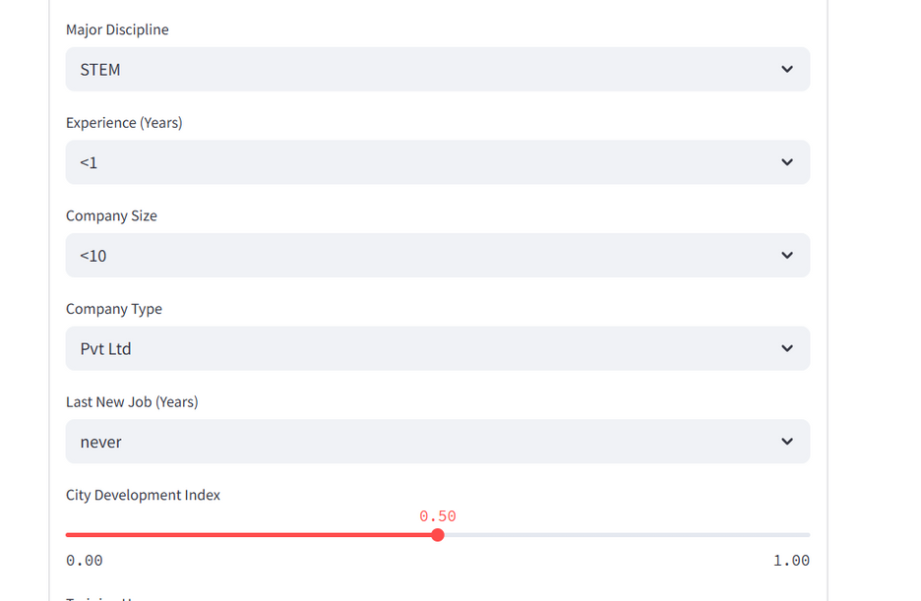
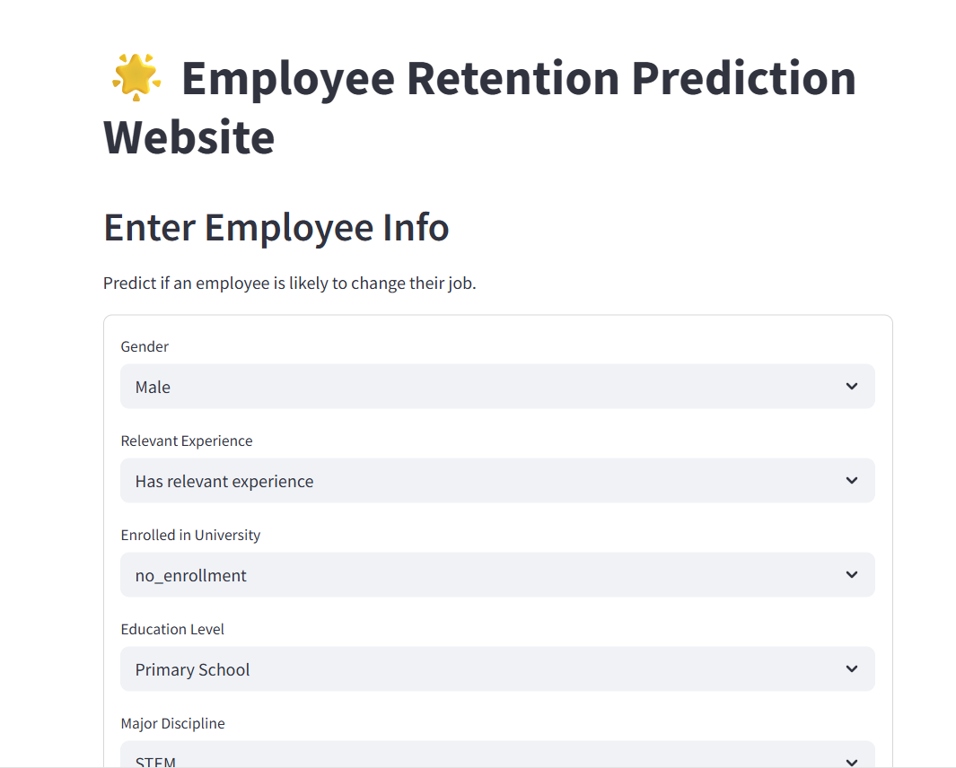

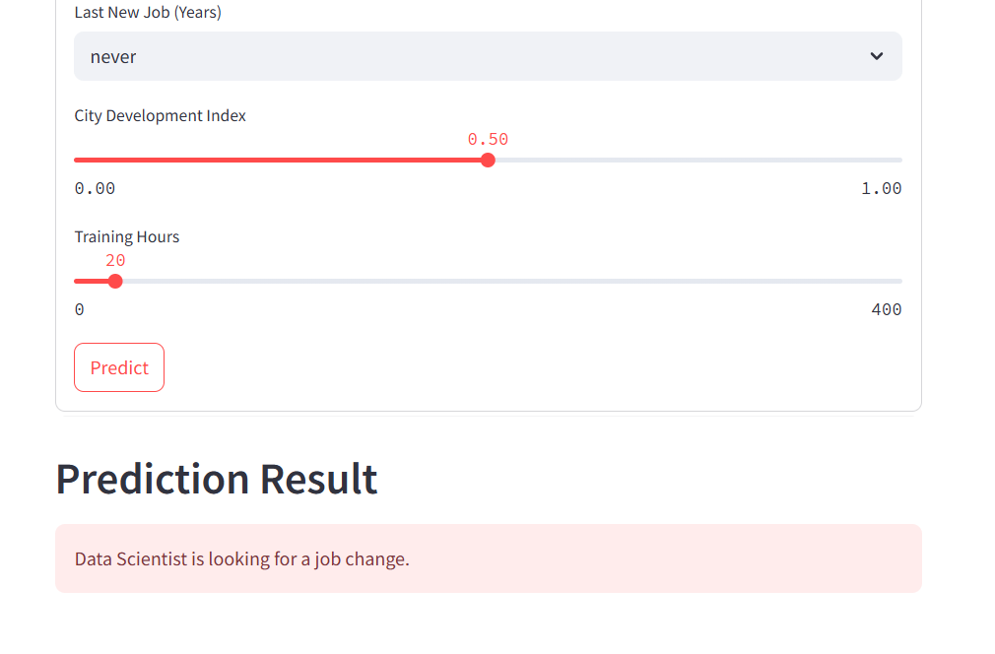
DEPLOYMENT

Slide 16
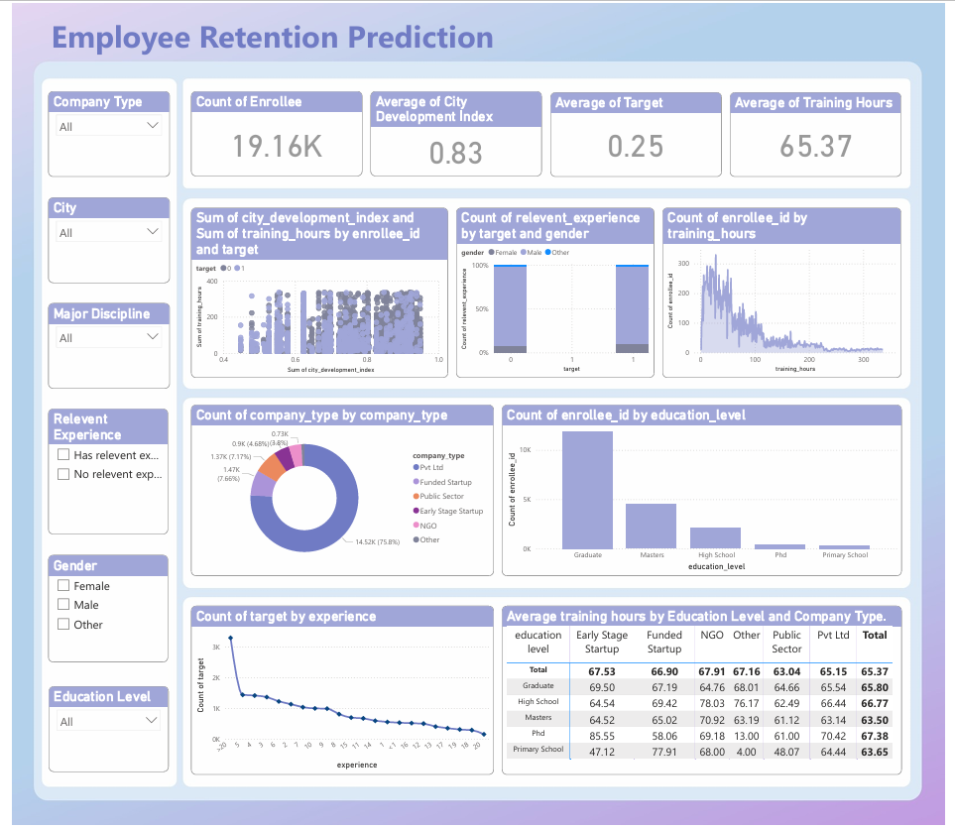
DASHBOARD

Slide 17
Questions ?
CONFIDENTIAL: The information in this document belongs to Boston Institute of Analytics LLC. Any unauthorized sharing of this material is prohibited and subject to legal action under breach of IP and confidentiality clauses.

Slide 18
Thank You!
CONFIDENTIAL: The information in this document belongs to Boston Institute of Analytics LLC. Any unauthorized sharing of this material is prohibited and subject to legal action under breach of IP and confidentiality clauses.

